Slide 1
00
V Chat
Abhishek Kushwaha , Aditya Vishvanathan
2115000022, 2115000082
BTech (CSE)
28 November, 2023
Your Name
University Name
Department Name
Date

Slide 2
Introduction
A comprehensive communication platform integrating features from Omegle, Tinder, and WhatsApp

Slide 3
OBJECTIVES
Create a Versatile Communication Platform
Enhance User Engagement and Interaction
Prioritize Security and Privacy
Optimize User Experience Across Platforms

Slide 4
Problem Statement
Fragmented Communication Platforms
Privacy Concerns and Insecurity
Why is it Important or Relevant:
Holistic Communication Experience
Trust and User Satisfaction

Slide 5
Literature Review
Omegle :
Summary: Provides random text and video chat for spontaneous conversations with strangers.
Gap: Lacks structured profiles, intentional matching, and a comprehensive set of communication tools.
Tinder :
Summary: Dating app with user profiles, swiping, and intentional matching for relationships.
Gap: Primarily dating-focused, missing random chat and secure, non-dating interaction features.
WhatsApp :
Summary: Widely-used messaging app with end-to-end encryption for secure communication.
Gap: Secure but lacks spontaneity of random chat and intentional friend-building features.
Gap Filled
1. Holistic Communication Platform:
Objective: Offer a versatile communication experience.
Outcome: Address fragmented experiences by integrating features from various platforms.
2. Privacy-Conscious and Diverse Interactions:
Objective: Prioritize security with diverse communication modes.
Outcome: Bridge the gap by ensuring robust security without compromising on the spontaneity of interactions.

Slide 6
Methodology
Full-Stack MERN Development (MongoDB, Express.js, React.js, Node.js)
Real-Time Communication with WebSocket
Secure Video Calls with WebRTC
User Authentication and Authorization
Explain the approach you took to solve the problem
Algorithms, techniques, tools, languages used

Slide 7
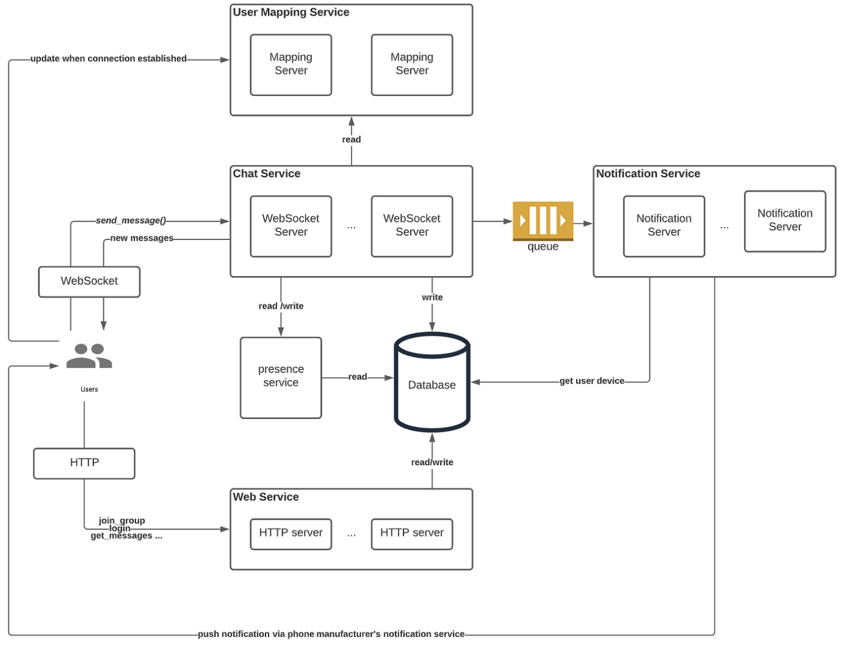
System Architecture
Frontend (Web and Mobile)
Backend (Node.js and Express.js)
Database (MongoDB)
Real-Time Communication (WebSocket)
Video Call Module (WebRTC)
Authentication and Authorization
Present the overall architecture of your system
Components and how they interact

Slide 8
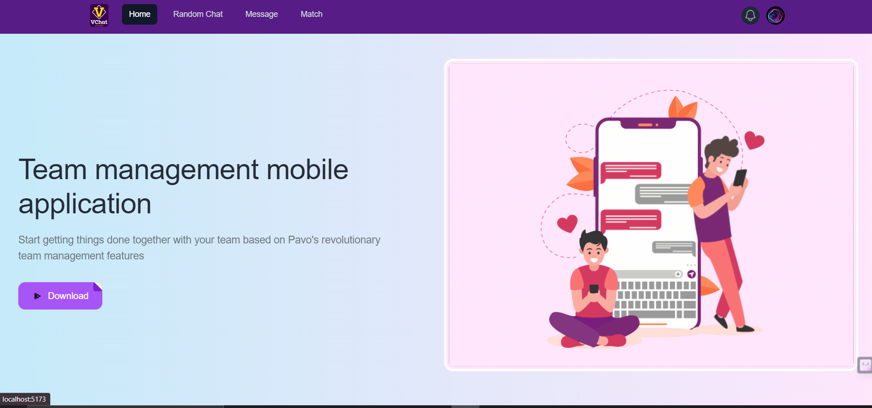
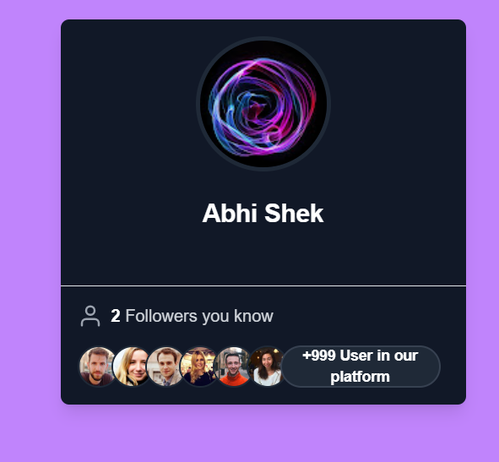
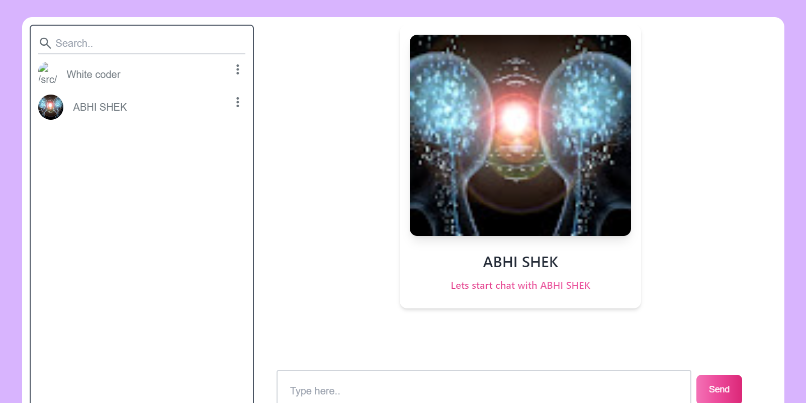
Implementation
Setting Up the MERN Stack
Real-Time Communication with WebSocket
WebRTC for Video Calls

Slide 9
Features
Unified Communication Platform
Random Chat Functionality
Versatile Media Support
Secure Video Calls with WebRTC
Intuitive Matching Algorithm
Web and Mobile Integration
Dynamic User Profiles
Highlight the key features of your project
Any unique functionalities

Slide 10
Results
Showcase the results or outcomes of your project
Graphs, charts, or any visual representation

Slide 11
Challenges Faced
Integration of Real-Time Communication
WebRTC Implementation for Video Calls
User Authentication and Security Measures
Cross-Platform Compatibility
User Privacy Concerns
User Experience Optimization

Slide 12
Future Work
Advanced Matching Algorithm
Group Chat and Community Features
Multilingual Support
Enhanced Media Sharing
Geolocation and Localized Features
Interactive User Profiles
Gamification and Rewards System
Live Streaming
Voice Chat Rooms
Personalized AI Recommendations

Slide 13
Conclusion
Unified Communication Experience
Privacy and Security
Innovative Features
Cross-Platform Integration
Future Expansion and Improvement
Versatility and Spontaneity

Slide 14
Acknowledgments
I would like to extend my sincere thanks to Mentor Robin Mam for her invaluable guidance and support throughout the development of the V Chat project.
I'm also grateful for the collaborative efforts of my dedicated team mate, whose commitment and contributions have significantly enriched the project.

Slide 15
Q&A
1. Q: How does V Chat ensure user privacy?
A: V Chat ensures user privacy through end-to-end encryption and secure authentication.
2. Q: What inspired the matching algorithm in V Chat?
A: The matching algorithm is inspired by Tinder, enhancing intentional connections based on user preferences.
3. Q: Can users access V Chat on both web and mobile?
A: Yes, V Chat is accessible on both web and mobile platforms for a seamless user experience.
4. Q: What role does WebSocket play in V Chat?
A: WebSocket enables real-time communication, ensuring instant message updates and seamless chat experiences.
5. Q: How does V Chat handle video calls?
A: V Chat utilizes WebRTC for secure and low-latency video calls, enhancing face-to-face Interactions.
6. Q: Are there plans for future feature additions in V Chat?
A: Yes, V Chat is committed to continuous improvement and will explore new features based on user feedback and emerging trends.

